Slide 1

Introduction to Clinical Pharmacology Chapter 11 Antiviral Drugs

Slide 2
Learning Objectives
Explain the uses, general drug actions, adverse reactions, contraindications, precautions, and interactions of antiviral drugs.
Distinguish important preadministration and ongoing assessment activities the nurse should perform on the client receiving an antiviral/antiretroviral drug.
List nursing diagnoses particular to a client taking an antiviral drug.
List possible goals for a client taking an antiviral/antiretroviral drug.
Examine ways to promote an optimal response to therapy and manage adverse reactions, and special considerations to keep in mind when educating the client and the family about the antiviral/antiretroviral drugs.

Slide 3

What is a virus?
A tiny infectious organism that enters the body, attaches to host cells, and uses the host cell to replicate by releasing its own DNA and RNA inside the cell
The host cell then releases more virus and the replicated viruses go and invade other cells
There are over 200 viruses that are known to produce diseases like:
Influenza
Warts
Cold sores
West Nile virus
Hepatitis C

Slide 4

Drugs Used to Treat Viruses
Antiviral
Antiretroviral

Slide 5
Antiviral Drugs—Actions
Combat viral infections
Target certain events that happen in the viral replication cycle which interfere with the virus’s ability to reproduce in a cell
Attempt to disable the protein part of the virus
Viruses can develop resistance
Development of antiviral drugs is difficult and expensive

Slide 6
Antiviral Drugs—Uses
Used to treat some viral infections caused by:
Cytomegalovirus (CMV) such as retinitis
CMV prevention in transplant recipients
Hepatitis B and C
Influenza A and B
Respiratory syncytial virus (RSV)
Unlabeled uses
Prevention of CMV and HSV infections after transplantation procedures
Varicella pneumonia

Slide 7
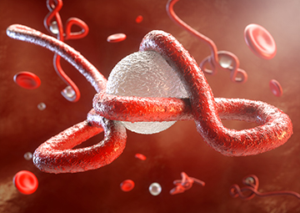
Antiviral Drugs—Practice Considerations
New viral infections evolve frequently (Ebola and coronaviruses)
New antivirals/antiretrovirals are constantly under development
Nurses need to rely on reference materials to see where progress is in the battle against viral infections

Slide 8

Antivirals—Adverse Reactions
Gastrointestinal System Reactions:
Nausea and vomiting
Diarrhea
Other Reactions:
Headache
Rash
Fever
Insomnia

Slide 9

Antivirals—Contraindications and Precautions
Contraindicated in clients:
with a history of allergies to the drug or other antivirals
Cidofovir should not be given to clients who have renal impairment or in combinations with medications that are nephrotoxic (aminoglycosides)
Ribavirin should not be used in clients with unstable cardiac disease
pregnancy (pregnancy category B and C) and lactation
Used cautiously in clients with:
Renal impairment
Low blood cell counts
History of epilepsy (rimantadine)
History of respiratory disease (zanamivir)
HBV (exacerbation of hepatitis after discontinuing adefovir dipivoxil or entecavir)

Slide 10
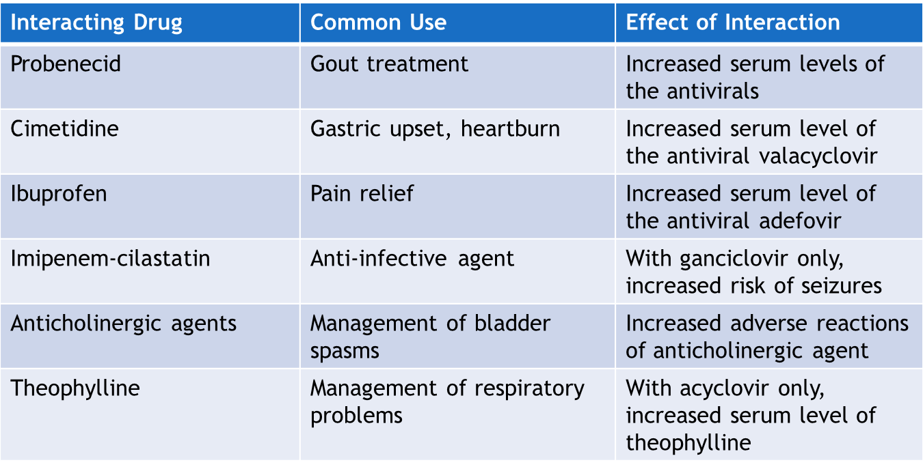
Antivirals—Interactions

Slide 11
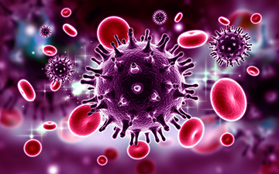
What is a retrovirus?
Retroviruses attack the host cell just like a virus except the difference that the RNA is the primary component of the virus
Contain reverse transcriptase that is used to turn the RNA of the virus into DNA—helps to produce more of the virus
Example: human immunodeficiency virus (HIV)
Retrovirus mutation happens more frequently
Highly active antiretroviral therapy (HAART)—due to rapid mutation, a multidrug approach is often used

Slide 12
Antiretroviral Drugs—Actions
Entry inhibitors prevent the attachment or fusion of HIV to a host cell for initial entry
Nonnucleoside reverse transcriptase inhibitors latch on to the reverse transcriptase molecule and block the ability to make viral DNA
Integrase inhibitors prevent enzymes from inserting HIV genetic material into the cell’s DNA
Reverse transcriptase inhibitors block the reverse transcriptase enzyme so HIV material cannot change into DNA in the new cell—no new copies of HIV
Protease inhibitors block the protease enzyme so new viral particles cannot mature

Slide 13
Antiretroviral Drugs—Uses
Used to treat some viral infections caused by:
Hepatitis B
HIV
Acquired immunodeficiency syndrome (AIDS)
Used to prevent HIV infection:
Combination of emtricitabine and tenofovir disoproxil

Slide 14
Antiretroviral Drugs—Adverse Reactions
Gastrointestinal System Reactions:
Nausea and vomiting
Diarrhea
Altered taste
Other Reactions:
Headache, fever, chills
Rash
Numbness and tingling in the circumoral area, peripherally, or both

Slide 15
Antiretroviral Drugs—Contraindications and Precautions
Contraindicated in clients:
with a history of allergies to the drug or other antiretrovirals
who are lactating
who are taking medications that interact with the antiretroviral drugs
Used cautiously in clients with:
diabetes mellitus
hepatic impairment
history of bladder or kidney stone formation
older adults taking didanosine—increased risk of pancreatitis
sulfonamide allergy (fosamprenavir and amprenavir)

Slide 16
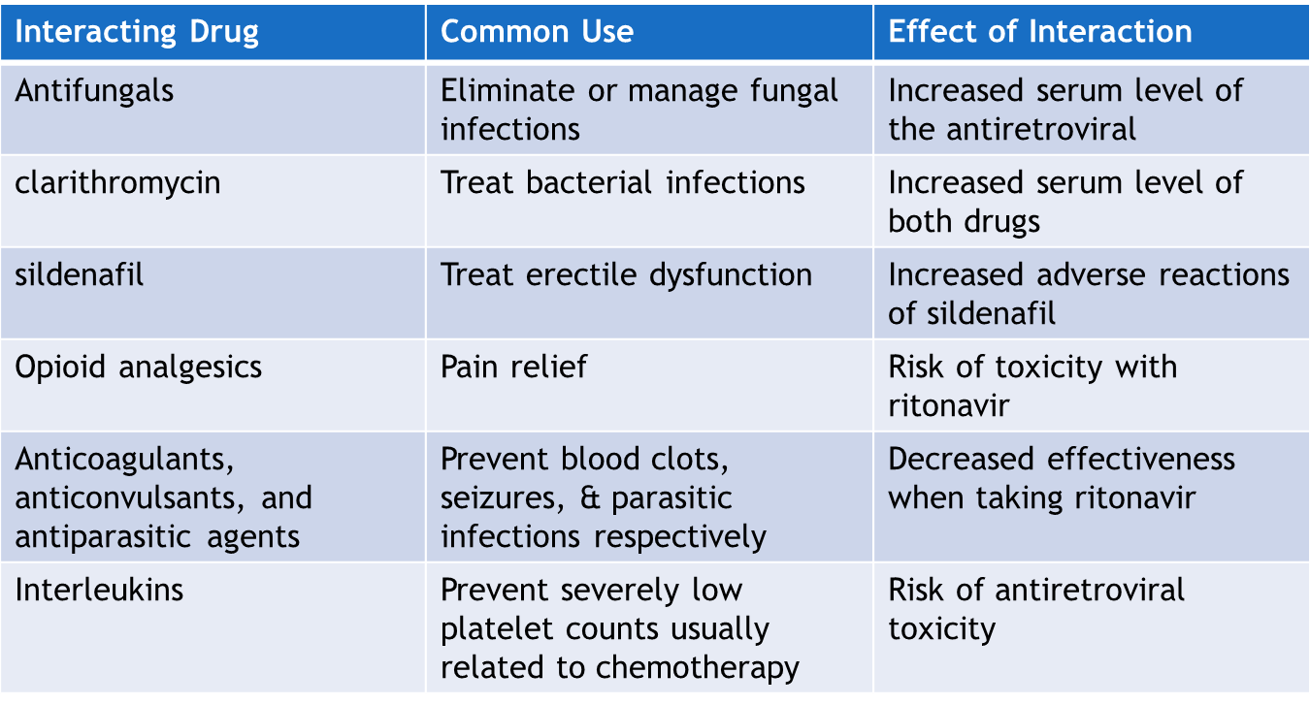
Antiretrovirals—Interactions

Slide 17
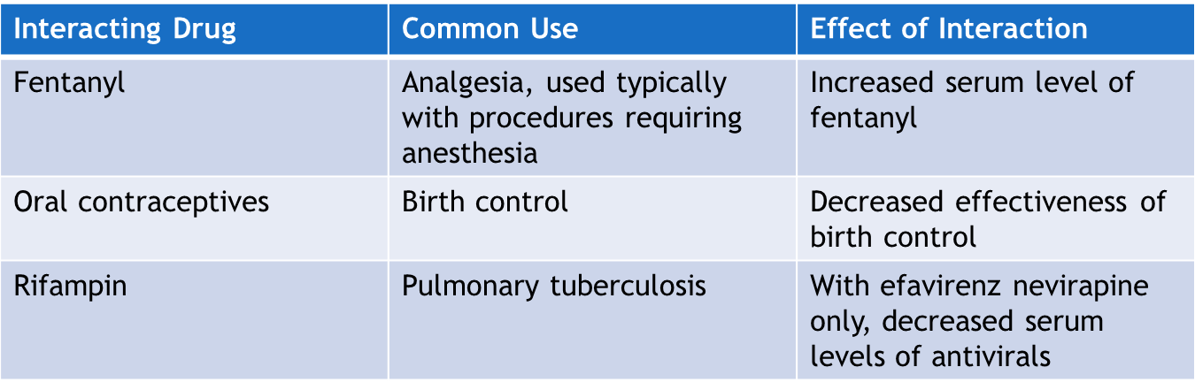
Antiretrovirals—Interactions continued

Slide 18

Pharmacology in Practice Exercise #1
Why are viruses so difficult to treat even with the use of antiviral medications? Select all that apply.
Viruses are tiny
Viruses can develop resistance to antiviral drugs
Viruses have a hard-to-penetrate outer layer
Viruses are large
Viruses replicate inside human cells

Slide 19
Nursing Process—Client Receiving an Antiviral/Antiretroviral Drug #1
Preadministration Assessment
Objective Data
Description of general appearance
Resistance to infection (complete blood count)
Vital signs
Female clients—pregnancy test/inquire about lactation
Inspect the body for signs of lesions as a baseline
Take photographs of any lesions as a baseline

Slide 20
Nursing Process—Client Receiving an Antiviral/Antiretroviral Drug #2
Preadministration Assessment (continued)
Subjective Data
Type and duration of symptoms
Remedies attempted before seeking care
Exposure to ill individuals if immunocompromised

Slide 21
Nursing Process—Client Receiving an Antiviral/Antiretroviral Drug #3
Ongoing Assessment
Depends on the reason for giving the antiviral/antiretroviral drug
Make frequent assessments for improvements of signs and symptoms and compare to baseline
Monitor and report any adverse reactions

Slide 22
Nursing Process—Client Receiving an Antiviral/Antiretroviral Drug #4
Nursing Diagnoses
Risk for Malnutrition related to adverse reaction of antiviral drugs
Risk for Impaired Skin Integrity related to initial infection, adverse drug reactions, and administration of the antiviral drug
Risk for Injury related to the client’s mental status, peripheral neuropathy, and generalized weakness
Body Image Disturbance related to body fat redistribution
Acute Pain related to kidney or bladder stones or inflammation caused by antiviral drugs

Slide 23
Nursing Process—Client Receiving an Antiviral/Antiretroviral Drug #5
Planning
Expected client outcomes depend on the reason for administration of the antiviral drug but may include:
Optimal response to therapy
Management of common adverse drug reactions
Confidence and understanding and adherence to the prescribed medication regimen

Slide 24
Nursing Process—Client Receiving an Antiviral/Antiretroviral Drug #6
Implementation
Promoting an optimal response to therapy
Allow time for the client and family members to ask questions about diagnosis, prognosis, and treatment methods
If drug will be given at home via IV, allow extra time for questions
Ribavirin: discard and replace the solution in the SPAG-2 aerosol generator every 24 hours; monitor respiratory function closely throughout therapy; is a pregnancy category X drug
Check recommended infusion rate prior to administration of IV antiviral to avoid toxicity by too rapid of an infusion

Slide 25
Pharmacology in Practice Exercise #2
A primary health care provider has prescribed 5400 mg of foscavir per day to be administered IV. The strength of the drug in the available solution is 24 mg/mL. How many mL of the solution in the syringe pump will the pharmacist have prepared for the nurse to administer one 5400-mg dose?
250 mL
225 mL
275 mL
200 mL

Slide 26

Nursing Process—Client Receiving an Antiviral/Antiretroviral Drug #7
Implementation
Monitoring and Managing Client Needs
Risk for Malnutrition
Many of the drugs can be given without regard to food except didanosine
Offer frequent small meals with soft nonirritating foods
Offer frequent sips of carbonated beverages or hot tea
Keep atmosphere clean and free of odors
Provide good oral care before and after meals
Consider taking the medication at bedtime—ask provider
Notify provider of sever nausea or vomiting

Slide 27
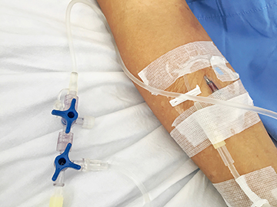
Nursing Process—Client Receiving an Antiviral/Antiretroviral Drug #8
Implementation
Monitoring and Managing Client Needs
Risk for Impaired Skin Integrity
Monitor any skin lesions carefully for worsening (notify provider) or improvement
Topical administration—use gloves to avoid spreading the infection; monitor for adverse reactions such as rash
IV administration closely observe the injection site for signs of phlebitis; prevent bruising, monitor vital signs every 4 hours or per provider orders

Slide 28
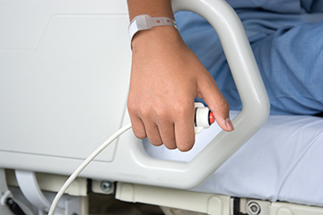
Nursing Process—Client Receiving an Antiviral/Antiretroviral Drug #9
Implementation
Monitoring and Managing Client Needs
Risk for Injury
Monitor acutely ill clients carefully due to fatigue, lethargy, dizziness, weakness, and assess for adverse reactions
Place call lights in a convenient place for the client
Plan activities with adequate rest periods
Watch for signs of peripheral neuropathy

Slide 29

Nursing Process—Client Receiving an Antiviral/Antiretroviral Drug #10
Implementation
Monitoring and Managing Client Needs
Disturbed Body Image
Clients taking protease inhibitors can experience redistribution of body fat (thinner arms and legs and rounder abdomen/enlarged breasts or behind the neck)
Spend time with clients
Encourage clients to verbalize their feelings regarding any change in appearance

Slide 30

Nursing Process—Client Receiving an Antiviral/Antiretroviral Drug #11
Implementation
Monitoring and Managing Client Needs
Acute Pain
Assess clients for pain when performing routine vital signs check
Explore any pain for location and intensity
Be aware that GI symptoms/pain can be a sign of pancreatitis
Report to the provider any sudden onset of pain

Slide 31
Pharmacology in Practice Exercise #3
A nurse is caring for a client who is on an antiretroviral therapy for HIV. The client has developed anorexia and nausea due to the different drugs. Which of the following interventions should the nurse perform in the given situation?
Reduce frequency of meals but increase quantity of meals
Ensure that the client’s diet includes soft, nonirritating foods
Keep the atmosphere clean and free of odors
Provide good oral care before and after meals

Slide 32

Nursing Process—Client Receiving an Antiviral/Antiretroviral Drug #12
Implementation—Educating the Client and Family
Develop a teaching plan for the client and family to include:
Explain the dosage regimen and advise to take the drug as prescribed only
If a dose is missed take the drug as soon as possible but do not double dose
Educate the client of potential adverse reactions, and explain the necessity of contacting the primary health care provider immediately if symptoms for adverse reactions occur

Slide 33
Nursing Process—Client Receiving an Antiviral/Antiretroviral Drug #13
Implementation—Educating the Client and Family (continued)
Develop a teaching plan for the client and family to include:
Educate the client that drugs do not cure viral infections but that they will shorten the course of the disease or promote healing
Educate the client that the drugs will not prevent the spread of infection to others
No sexual contact while lesions are present on the genitalia
Notify the provider of adverse reactions
Photosensitivity precautions when indicated
Some drugs can affect mental status—safety regarding driving, standing and when to report symptoms to provider

Slide 34
Nursing Process—Client Receiving an Antiviral/Antiretroviral Drug #14
Evaluation
Was the therapeutic response achieved? Is there evidence of the management of infection and viral load?
Were adverse reactions: identified, reported, and managed?
Client maintains adequate nutrition status
Skin is intact and free of inflammation, irritation, infection, or ulcerations
No evidence of injury
Perceptions of body changes are managed successfully
Client is free of pain
Did client and family express confidence and demonstrate understanding of drug regimen?

Slide 35
Turn and Talk—Case Study
A 55-year-old client has been diagnosed HIV positive for 5 years. The client is currently taking the antiretroviral combination drug, Atripla—one tablet by mouth daily. They present to the physician’s office complaining of pain in the mouth with white patches on the tongue and cheeks
Define the antivirals in the medication—Atripla. While triaging the client, what information should the nurse obtain?
The client tells the nurse they started taking St. John’s wort having heard it had antiviral effects and they felt a bit depressed lately. What should the nurse tell the client about the St. John’s wort?
The physician writes a prescription for the client to receive fluconazole (Diflucan) 200 mg on day 1 and 100 mg on days 2 through 14. What should the nurse tell the client?

